Slide 1
Consuming External Web Services
May 1, 2014
Notes:
Guidewire training materials contain Guidewire proprietary information that is subject to confidentiality and non-disclosure agreements. You agree to use the information in this manual solely for the purpose of training to implement Guidewire software solutions. You also agree not to disclose the information in this manual to third parties or copy this manual without prior written consent from Guidewire. Guidewire training may be given only by Guidewire employees or certified Guidewire partners under the appropriate agreement with Guidewire.

Slide 2
Describe how Guidewire applications and external systems can integrate with each other using web services
Determine a given web service's binding style
Consume external RPCE web services from Guidewire
Consume external WS-I web services from Guidewire

Slide 3
Web services overview
Resources for consuming external web services
Consuming external RPC web services
Consuming external WS-I web services

Slide 4

Web Service
Web Service
Guidewire application
External system
A web service is a collection of application program interfaces (APIs) that lets one application send and receive information from another, usually synchronously
Notes:
A user interface lets humans send and receive information from an application synchronously. A web service is interface for one application to communicate to another application.
Web services are not inherently synchronous. The Web Services Interoperability Organization standard does support asynchronous web services. By convention, web service names typically end in "API".
Guidewire implementations support asynchronous calls to web services published by external systems. A web service typically is a synchronous web service. All web services hosted by Guidewire are synchronous.
For asynchronous calls into Guidewire, you should consider using startable plugins. For more information about startable plugins, refer to documentation.
Web service consumers must know what communication protocol to use for sending messages to the service, along with the specific mechanics involved in using the given protocol including command use, error codes, and headers.

Slide 5

WSDL
Consumer
WSDL
Publisher
exchange rate system
CurrencyAPI
Service: CurrencyAPI - Method: getRate - Input: toCurrency (String) - Input: fromCurrency (String) - Output: rate (float)
A WSDL (Web Services Description Language) is an XML file that defines the operations available for a web service and the required input and output values
Generated by the "publisher"
Used by the "consumer" to create requests
Notes:
A WSDL describes a way to group messages into operations and operations into interfaces. It also provides a way to define bindings for each interface and protocol combination as well as the endpoint address for each one. A WSDL provides the XML grammar for describing how a consumer of a web service can interact with a web service. A complete WSDL definition contains all of the information necessary to invoke a Web service.
The structure of a WSDL includes several elements:
A Type defines schemas (XSDs) or imports other WSDL or XSD files that describe each method argument type and each method return type.
A portType is an abstract set of operations defined by an exchange of messages supported by one or more endpoints. Each operation element contains an input and output element. Output elements have one or more related fault elements. The order of the input and output defines the message exchange pattern. The WSDL 1.2 term for portType is interface.
A binding is a concrete protocol and data formation for a particular portType. It influences the way abstract messages are encoded on the wire by specifying the style of service (document vs. RPC) and the encoding mechanism (literal vs. encoded).
A service supports one or more bindings for a given portType, but each binding should be accessible at a unique address identified by a URI, also referred to as a Web service endpoint.
A message consists of one or more part elements, where each part is associated with either an element (when using document style) or a type (when using RPC style). Although the message parts typically refer to XML types or elements, they can also refer to non-XML types. It defines an abstract message that can serve as the input or output of an operation.

Slide 6

SOAP
Vehicle Request (XML)
Vehicle Report (XML)
SOAP (originally Simple Object Access Protocol) is a protocol specification for exchanging structured information through a web service
Examples of structure information
Simple data such as integers and Booleans
JSON
Complex XML data structures
Notes:
A protocol is a set of rules used by computers to communicate with each other across a network. A protocol is a convention or standard that controls or enables the connection, communication, and data transfer between computing endpoints. In its simplest form, a protocol can be defined as the rules governing the syntax, semantics, and synchronization of communication. Protocols may be implemented by hardware, software, or a combination of the two.
Simple Object Access Protocol (SOAP) is a "request and response” protocol transported, in the majority of cases, over HTTP. SOAP describes objects and data as XML. SOAP supports remote APIs as both platform-neutral and language-neutral.
External systems must use WSDL and SOAP to call a web service using the SOAP protocol. This includes systems written in Java and Gosu.
When a web service is imported into Guidewire, the Gosu language handles all aspects of object serialization, object deserialization, basic authentication, and SOAP fault handling.
.

Slide 7
WSDL binding styles
<soap12:binding transport="http://schemas.xmlsoap.org/soap/http" style="document"/>
…
<soap12:body use="literal"/>
WSDL bindings defines for a web service
Protocol details: http
Message format: body as literal
Four possible binding styles
RPC encoded
RPC literal
Document encoded
Document literal (WS-I)
Notes:
A Web Services Description Language (WSDL) binding style can be Remote Procedure Call (RPC) or Document. WSDL is an XML-based language for describing web services and how to access the web services.
Gosu supports WS-I RPC Literal for Gosu web service client code. However, it does so by automatically and transparently converting any WSDL for RPC literal mode into WSDL for document literal mode. The focus of the Gosu documentation for WS-I web services is the support for Document Literal encoding. This lesson uses the phrase "WS-I" to refer exclusively to Document Literal encoding.
Guidewire has deprecated support for RPC-encoded web services. Guidewire encourages customers to upgrade existing RPC encoded web services to web service collections using document literal encoding.

Slide 8
Which WSDL binding should I use?
Deprecated support for RPC-encoded
<wsdlsoap:binding style="rpc" />
Remote procedure call encoded
Data encoding is specific to each call
Difficult to validate data (no XSD)
Web service endpoints use RPC-encoded binding
Document literal encoding (WS-I)
<soap12:binding style="document"/>
XSD attached to the WSDL validates XML
Webservice collections (WSC) consume WSDLs that use WS-I documents literal binding
!
RPC encoded WSDL
Document literal WSDL
XSD
Notes:
The Web Services Interoperability Organization (WS-I) is an industry consortium chartered to promote interoperability among the stack of web services specifications. WS-I does not define standards for web services; rather, it creates guidelines and tests for interoperability.One of the big differences between WS-I and older styles of web services is how the client and server encode API parameters and return results.
The older style of web services is called Remote Procedure Call encoded (RPCE) web services. The bulk of the incoming and outgoing data are encoded in a special way that does not conform to XSD files. Many older systems use RPCE web services, but there are major downsides with this approach. Most notably, the encoding is specific to each remote procedure call, so it is difficult to validate XML data in RPC-encoded responses. It would be more convenient to use standard XML validators which rely on XSDs to define the structure of the main content.
When you use the WS-I standards, you can use an alternative encoding called Document Literal encoding (document/literal). Each document-literal-encoded SOAP message contains an embedded XML document for each method argument or return value. The schema for each of these documents is an industry-standard XSD file. The WSDL that describes how to talk to the published WS-I service includes a complete XSD describing the format of the embedded XML document. The outer message is very simple, and the inner XML document contains all of the complexity. Anything that an XSD can define becomes a valid payload or return value.
The WS-I standard also supports a mode called RPC Literal (RPC/literal) instead of Document Literal. Despite the similarity in name, WS-I RPC Literal mode is not closely related to RPC encoding

Slide 9

Web services for Guidewire integration
exchange rate system
get exchange rates
CurrencyAPI
make payment
financial system
FinancialsAPI
Guidewire can consume and publish web services
This lesson focuses on how to consume external web services
The next lesson discusses how to publish Guidewire web services for other systems to consume
Notes:
In the example above:
The exchange rate system is the publisher of the CurrencyAPI web service. Guidewire is a consumer of that service and uses it to get exchange rates.
Guidewire is the publisher of the FinancialsAPI web service. The financial system is a consumer of that service and uses it to make payments.
This lesson discusses how to consume external web services. The "Publishing Guidewire Web Services" lesson discusses how to publish Guidewire web services.

Slide 10
Web services overview
Resources for consuming external web services
Consuming external RPC web services
Consuming external WS-I web services

Slide 11
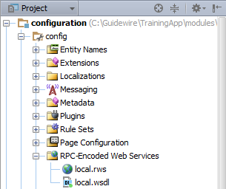
Deprecated RPCE web services
Deprecated support for RCP-Encoded Web Services
Update existing web services to WS-I document literal web service collection
!
RPC-Encoded Web Services
/configuration/config/webservices
Web service endpoints
Connect to RPCE web services
Notes:
Guidewire has deprecated support for RPC-encoded web services. Consider upgrading existing web services to WS-I-Document literal web service collection. However, it remains possible to consume RCPE web services in Guidewire 8 applications.

Slide 12
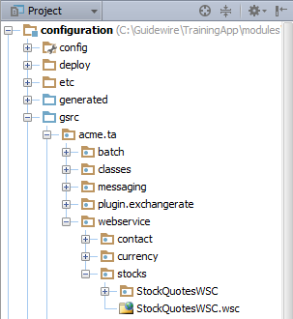
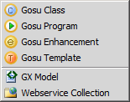
Webservice collection (WSC)
Webservice collection (WSC)
Connect to WS-I web services
/configuration/gsrc
Create Package
Create in the package a Webservice collection

Slide 13
Web services overview
Resources for consuming external web services
Consuming external RPC web services
Consuming external WS-I web services

Slide 14
Web service endpoints
ChemicalElement
RPCE
ChemicalElement WSDL
A web service endpoint is a reference to an Remote Procedure Call (RPC) style binding that is encoded
RPCE external web service
Consists of the external web service's WSDL
Notes:
Guidewire has deprecated support for RPC-encoded web services. Consider upgrading existing web services to WS-I-Document literal web service collection. However, it remains possible to consume RCPE web services in Guidewire 8 applications.

Slide 15
Consuming an external RPCE web service
Create a new web service endpoint
Load the resources
Deploy your changes
Reference the web service in Gosu as needed

Slide 16
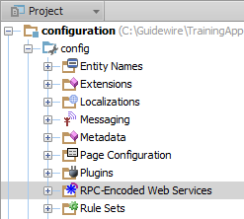
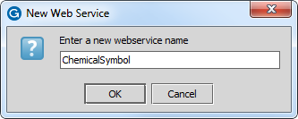

Step 1: Create a web service endpoint
/configuration/config/webservices
RPC-Encoded Web Services
New → Web Service
Notes:
To create a new web service endpoint:
In Project view, in configuration/config, select RPC-Encoded Web Services. Right click to open the context menu. Select New→Web Service.
Provide a name for the web service endpoint. Click OK.
Initially, a new web service endpoint has no resources.

Slide 17
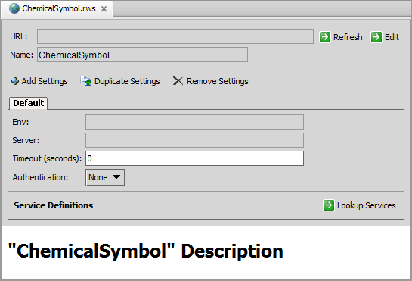
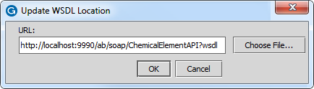
Step 2: Load the resources
Specify the WSDL URL
To fetch WSDL, the external system must be running
Notes:
To add resources to an endpoint:
In the editor, click Edit.
In the dialog, enter web service endpoint URL for the WSDL
Click OK.
This loads the WSDL into Guidewire. Information about the WSDL methods and exceptions appear in the bottom pane.
For an existing web service endpoint, you can refresh the WSDL at any time by clicking "Refresh".
In order to replicate these steps in TrainingApp, ExternalApp must be running.

Slide 18
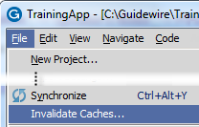
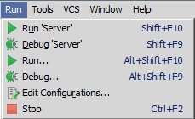
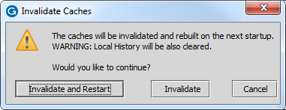
Step 3: Deploy your changes
Invalidate Caches and Restart Studio
Restart Server
To call the new web service collection, restart the server from Guidewire Studio
Stop (if running)
Run 'Server or Debug 'Server'
To reference the web service API in Studio, invalidate the caches and restart Studio
Notes:
To reference the newly added web service in Gosu code in Guidewire Studio, you need to first invalidate the caches and restart Guidewire Studio.
To clear the Guidewire Studio caches, from the menu bar, select File and then select Invalidate Caches. In the dialog, click Invalidate and Restart.
After Guidewire Studio restarts, you will be able to reference the web service endpoint in Gosu code.
In order to instantiate the web service endpoint in Gosu code, you must restart the Guidewire application.

Slide 19
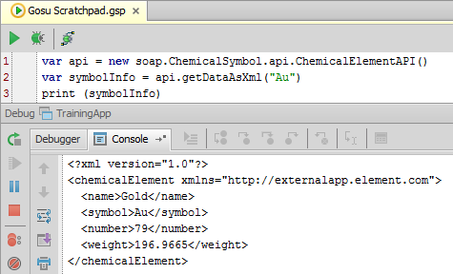
Step 4: Reference the web service in Gosu
1 var api = new soap.ChemicalSymbol.api.ChemicalElementAPI()
2 var symbolInfo = api.getDataAsXml("Au")
3 print (symbolInfo)
new soap.endpoint.api.ServiceName()
Syntax to create an endpoint API instance
Verify reference
Debug Server from Guidewire Studio
Open Gosu Scratchpad
Write code to call web service method
Run in Debug Process
Review Debug Console output
Notes:
Keep in mind that the syntax above simply retrieves the return value of the service. Further processing of the return value may be needed. For example, if the return value is XML data, you may need to parse the data to get the value you need. For further information on parsing XML, refer to the "Gosu and XML" lesson.
In order to replicate this step in TrainingApp, ExternalApp must be running.

Slide 20
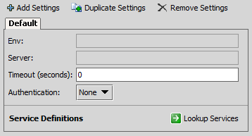
Additional configuration options
1 var api = new soap.ChemicalSymbol.api.ChemicalElementApi()
2 // set authentication
3 var handler = new gw.api.soap.GWAuthenticationHandler("su","gw")
4 api.addHandler(handler)
5 var symbolInfo = api.getDataAsXml("Au")
6 print (symbolInfo)
GWAutheticationHandler()
Specify a handler for authentication
Configure default or add additional settings in editor
Environment
Server
Timeout
Service definitions
Notes:
With web service endpoints, some of the additional options are configured in the endpoint entry in Studio, and others are accessed in the Gosu code that makes the API instance. For example:
In the endpoint entry in Studio, you can:
Specify a timeout
Specify an override URL
From the API object, you can:
Specify a handler for authentication (as shown above)
For more information on how to set each option, refer to the Integration Guide.

Slide 21
Web services overview
Resources for consuming external web services
Consuming external RPC web services
Consuming external WS-I web services

Slide 22
Web service collections
stockquotesWSC
WS-I
stockquote WSDL
stockquote XSD
related WSDLs (if any)
related XSDs (if any)
A web service collection is a collection of references to an external WS-I web service
It consists of one or more resources including:
Primary WSDLs and XSDs for the external web service
Any WSDLs and XSDs referenced by the primary files
Notes:
A given web service collection contains only one copy of each file, even if multiple files reference that file. (For example, if two WSDLs in the web service collection reference the same XSD, there is only one copy of the XSD in the web service collection.)

Slide 23
Consuming an external WS-I web service
Create a package for the web service collection
Create a new web service collection
Fetch the resources
Deploy your changes
Reference the web service in Gosu as needed

Slide 24
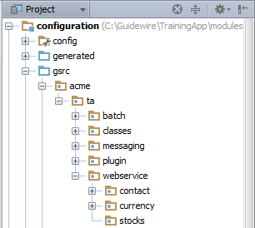
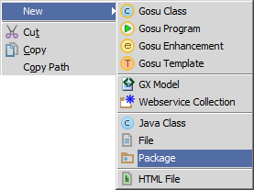
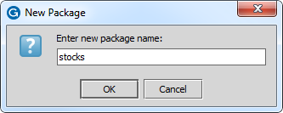
Step 1: Create a package
/configuration/gsrc/
Create package
New → Package
Guidewire naming convention recommendation
<company>.<app_code>.webservice.<functional_area>
Example: acme.ta.webservice.stocks
Notes:
To create a package:
1. Right-click the package that is to be parent of new package.
2. Name the package. The name must be unique for the given parent.
The package roots "com.guidewire" and "gw" are reserved. You should not create any child packages in either of these packages.
For more information on recommended naming conventions for packages, refer to the "Gosu for Integration" lesson.

Slide 25
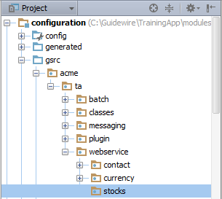
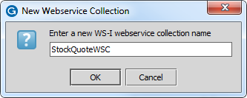
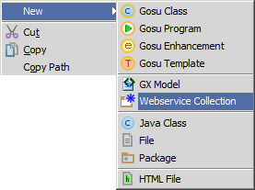
Step 2: Create a web service collection
Select package
New → Webservice Collection
Initially, a new web service collection has no resources

Slide 26
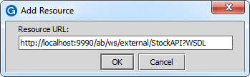
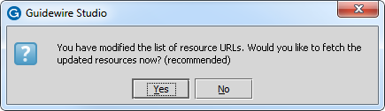
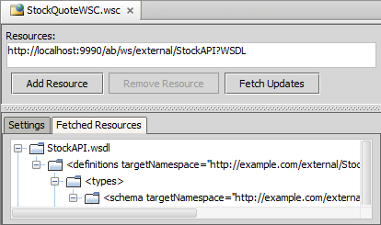

Step 3: Fetch the resources
Specify the WSDL URL
Click Add Resource
Fetch the WSDL
the external system must be running
Project view shows fetched resource
WSC folder
XSD and WSDL files
Notes:
To add resources to a collection:
1. In the editor, click Add Resource.
2. In the Add Resource dialog, enter the URL for the WSDL of the web service. Click OK to add the resource to the Fetched Resources pane. At this point, the resource has not been fetched.
3. In the dialog, click Yes to fetch the resources.
4. In the editor, click Fetch Updates to update an existing resource.
In order to replicate these steps in TrainingApp, ExternalApp must be running.

Slide 27
Step 4: Deploy your changes
Invalidate Caches and Restart Studio
Restart Server
To call the new web service collection, restart the server from Guidewire Studio
Stop (if running)
Run 'Server or Debug 'Server'
To reference the web service API in Studio, invalidate the caches and restart Studio
Notes:
To reference the newly added web service in Gosu code in Guidewire Studio, you need to first invalidate the caches and restart Guidewire Studio.
To clear the Guidewire Studio caches, from the menu bar, select File and then select Invalidate Caches. In the dialog, click Invalidate and Restart.
After Guidewire Studio restarts, you will be able to reference the web service collection in Gosu code.
In order to instantiate the web service collection in Gosu code, you must restart the Guidewire application.

Slide 28
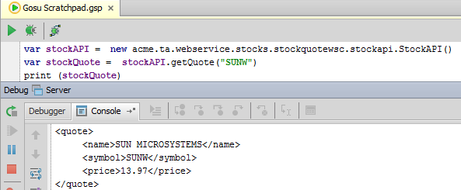
Step 5: Reference the web service in Gosu
1 var stockAPI = new acme.ta.webservice.stocks.stockquotewsc.stockapi.StockAPI()
2 var stockQuote = stockAPI.getQuote("SUNW") 3 print (stockQuote)
new packagepath.webservicecollection. Wsdlname.ServiceName()
Syntax to create an web service collection API instance:
ServiceName() is case sensitive; use value of name attribute
No reference?
File → Invalidate caches… → Invalidate and Restart
Notes:
The web service collection name is converted to lower-case letters. For example, the web service collection in the example is named StockQuoteWSC., but it is referenced in Gosu as "stockquoteswsc". The Service name is case sensitive.
From Gosu, there are three types of WS-I web service client connections:
Standard round trip methods (synchronous request and response)
One-way methods (synchronous request without response)
Asynchronous round trip methods (send the request and immediately return to the caller, and check later to see if the request finished).
A typical WS-I method invocation has two parts: the SOAP request and the SOAP response. WS-I supports a concept called one-way methods. The WSDL defines a one-way method to not provide a SOAP response. The transport layer (HTTP) may send a response back to the client, however, but it contains no SOAP response. Gosu fully supports calling one-way methods. Your web service client code does not have to do anything special to handle one-way methods. Gosu automatically handles the one-way method if the WSDL defines a one-way method. For more information on one-way methods, refer to the Integration Guide.
Gosu supports optional asynchronous calls to web services. For more information, refer to the Integration Guide.
Further processing of the return value may be needed. For example, if the return value is XML data, you may need to parse the data to get the value you need. For further information on parsing XML, refer to the "Gosu and XML" lesson.

Slide 29
Additional configuration options
1 var stockAPI =
2 new acme.ta.webservice.stocks.stockquotewsc.stockapi.StockAPI()
3 // set authentication properties
4 stockAPI.Config.Http.Authentication.Basic.Username = "su"
5 stockAPI.Config.Http.Authentication.Basic.Password = "gw"
6 // set timeout to 30 seconds (30000 milliseconds)
7 stockAPI.Config.CallTimeout = 30000
8 var stockQuote = stockAPI.getQuote("GWRE")
9 print (stockQuote)
Specify additional configurations for the API:
Authentication information
Timeout period
Custom SOAP headers
HTTP headers
Server override URL
Notes:
If a web service does require authentication, then you can set the user name and password using the following syntax:
apiInstance.Config.Http.Authentication.Basic.Username = "userName"
apiInstance.Config.Http.Authentication.Basic.Password = "password"
If you need to add encryption, authentication, or digital signatures, you can do so by modifying options on the API object's Config namespace. For more information on how to set each option, refer to the Integration Guide.

Slide 30
Describe how Guidewire applications and external systems can integrate with each other using web services
Determine a given web service's binding style
Consume external RPCE web services from Guidewire
Consume external WS-I web services from Guidewire

Slide 31
What is a WSDL? What does it describe?
With regards to WSDL binding styles:
What are the two types of styles?
How can you tell the style used by a given WSDL?
What Guidewire resource is used to consume each style?
What two types of files can be included as resources in a web service collection?
You have an API instance named "conversionAPI". Under what circumstances would you set properties on conversionAPI.Config?
Notes:
Answers
1. A WSDL is an XML document that describes how an external system can interact with a web service.
2a. RPCE and WS-I (or document literal)
2b. The style attribute in the WSDL's binding tag
2c. Web service endpoints are used to consume RPCE WSDLs; Web service collections are used to consume WS-I WSDLs
3. WSDLs and XSDs
4. You would set values there if you needed to provide authentication information, timeouts, or custom SOAP headers.

